Slide 1
Automating Instagram using Appium
M.Deekshitha
192011293

Slide 2
ABSTRACT
To automate the Instagram application which is mobile photo-sharing, video-sharing and social networking service that enables its users to take pictures and videos
And also share them on a variety of social media networking platforms, such as Facebook, Twitter, Tumbler etc.
The test processes include-
- Testing of code
- Test scenarios

Slide 3
OBJECTIVE
To test the Instagram applications using testcases.
And noting down the test scenarios i.e., positive and negative scenarios.

Slide 4

PROPOSED SYSTEM
Installation of the softwares to automate the Instagram application are -
- Android studio : Visualization
- Visual Studio Code : To write code
- Appium : To automate the application
Performing tests for Instagram application such as –
- Verifying login credentials such as email and password.
- Verifying the number of viewers who view the story.
- Number of likes, comments and shares.
- Uploading a post.
- Reels
- Feed
- Friend Request
- Followers and following
- Blocked accounts
- Highlights

Slide 5
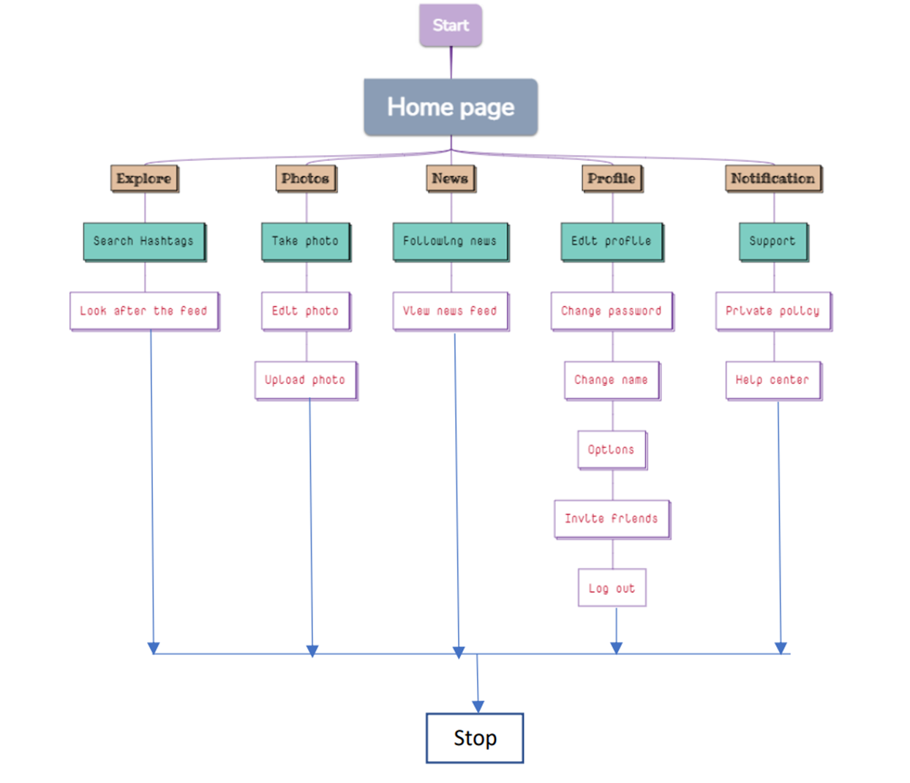
DATA FLOW DIAGRAM

Slide 6
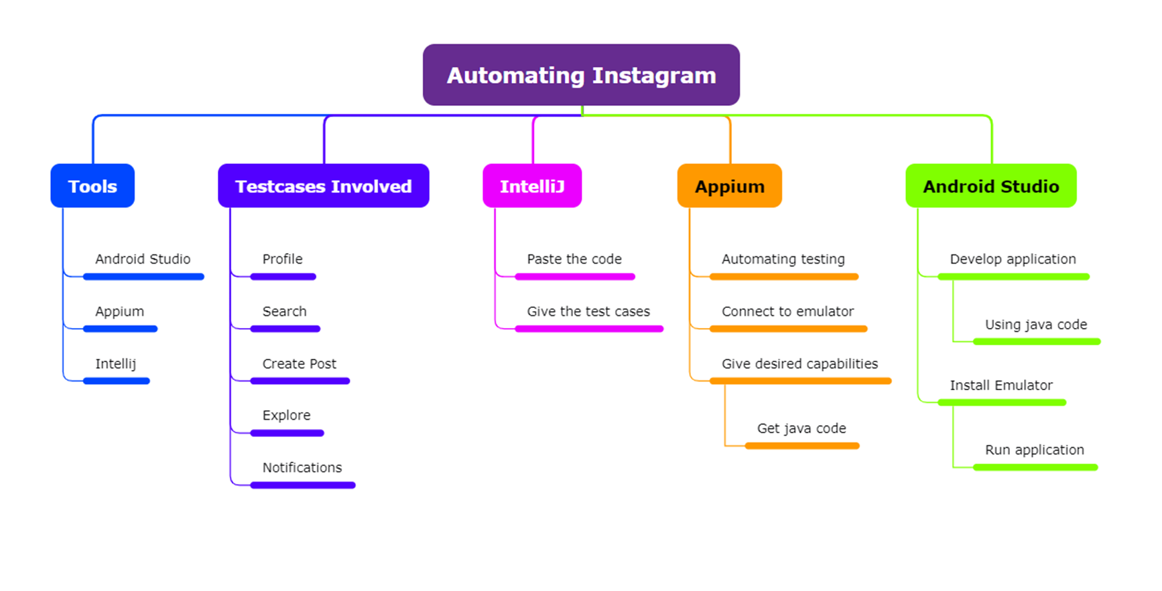
CONCEPT MAPPING

Slide 7

TEST SCENARIOS
TEST CASES | TYPES-POSITIVE/NEGATIVE
Enter the valid username and password | Positive
Enter the invalid username and password | X Negative
Check if strangers can check the story in private account | X Negative
Verify whether the share button is clickable or not | Positive
Verify whether the blocked contacts can message | X Negative
Check if the user can post the pictures from gallery or camera | Positive
Check if the user can post the multiple pics at the same time | Positive
Verify whether the user can text multiple persons at a time | X Negative
Verify whether hidden accounts can view the story | X Negative
Check if the user can accept or delete the follow requests | Positive
Verify whether the user can click photos in Instagram | Positive
Verify whether the user can share and edit their profile | Positive
Check if the user can like the pictures of the other accounts multiple times | X Negative

Slide 8




APP AND TOOLS
IntelliJ
Appium Server
Android Studio
Appium Inspector

Slide 9
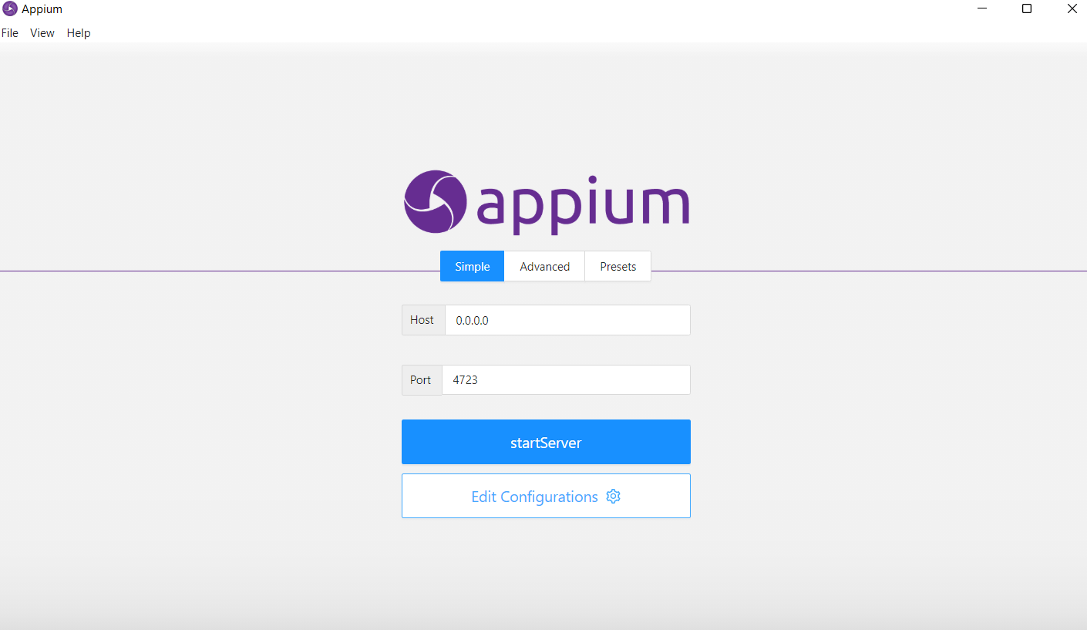
INSTALLATION

Slide 10
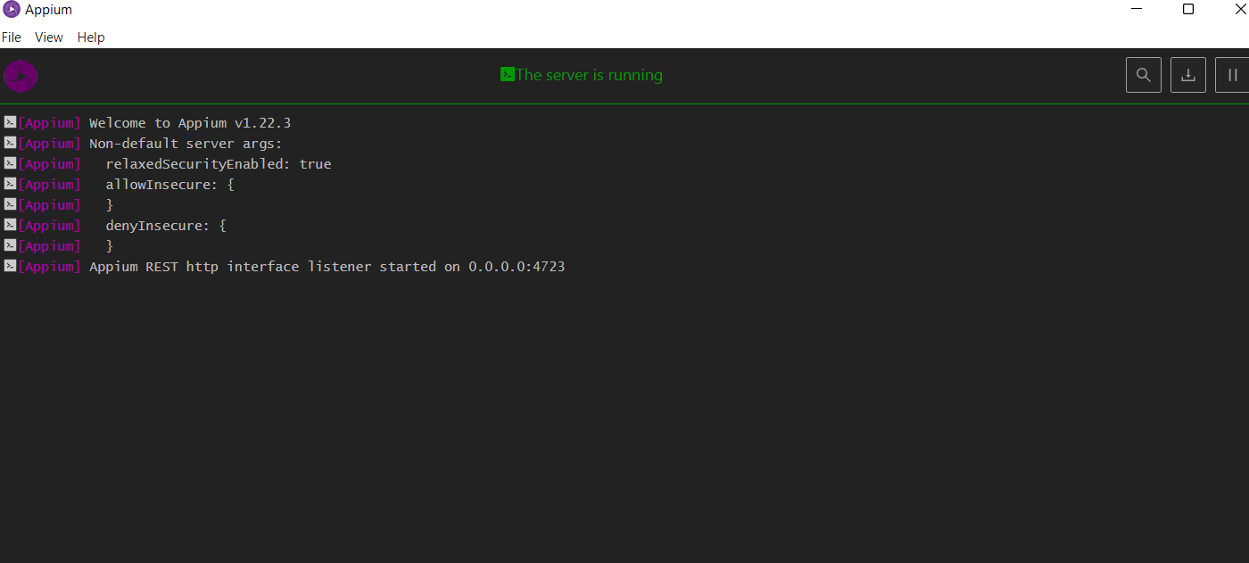
INSTALLATION

Slide 11
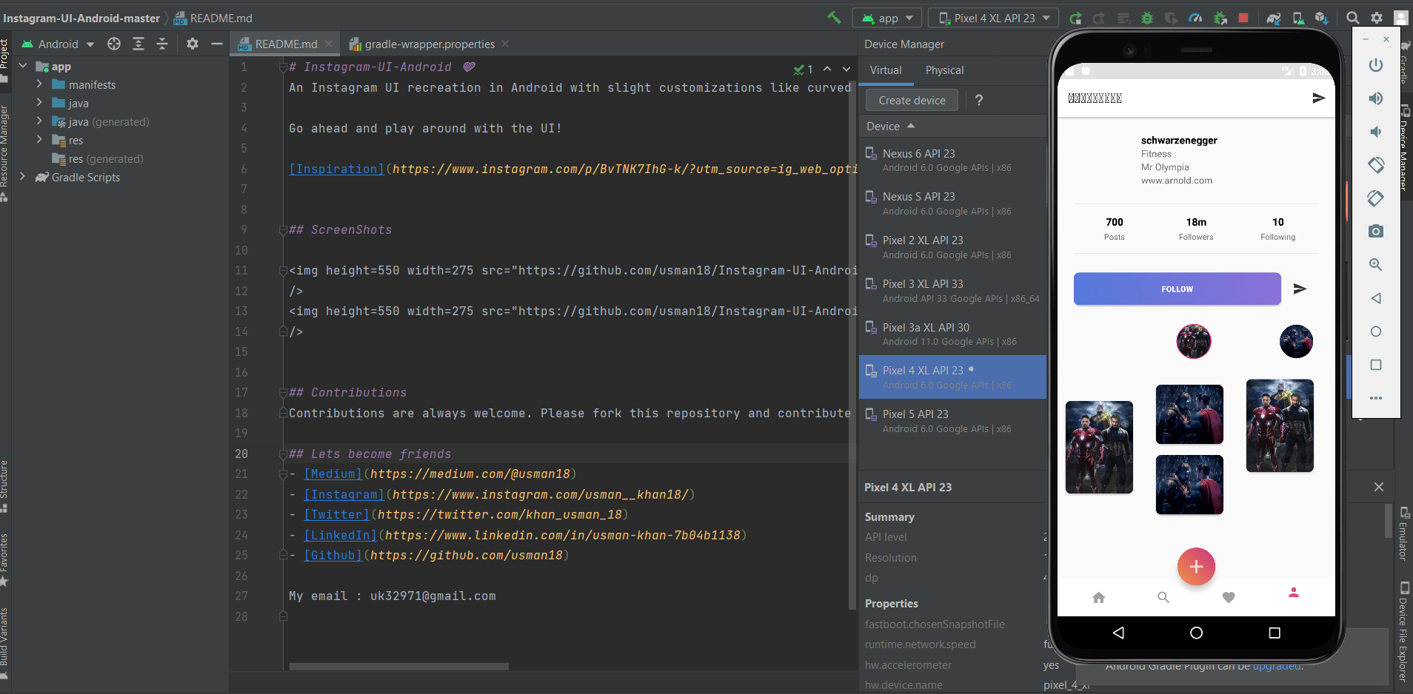
IMPLEMENTATION OF TESTING
Android studio

Slide 12
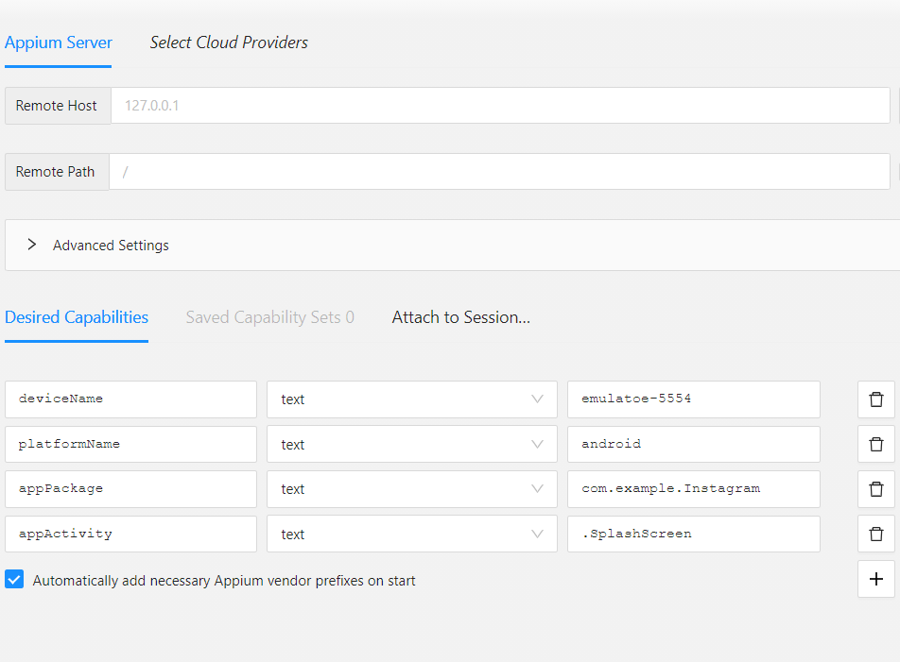
IMPLEMENTATION OF TESTING
Appium Inspector

Slide 13

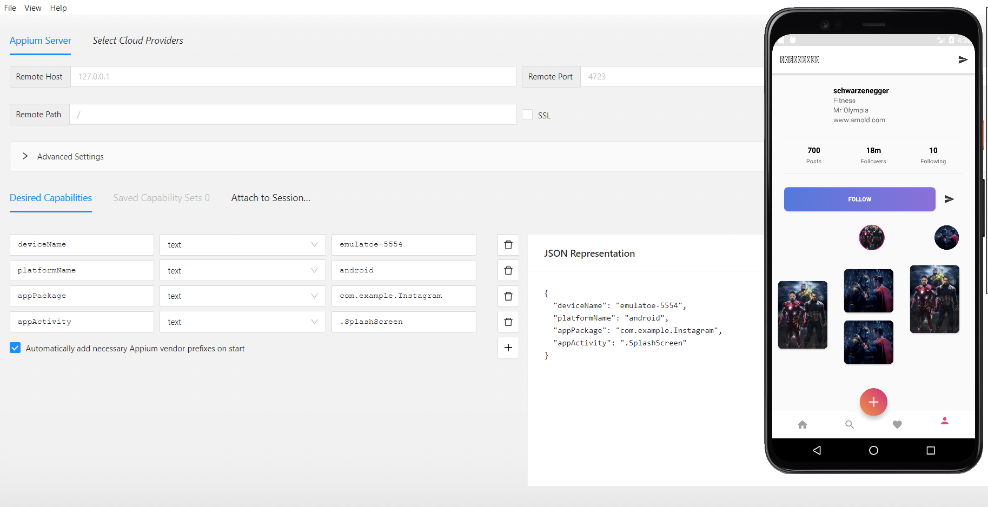
TESTING OUTPUTS

Slide 14
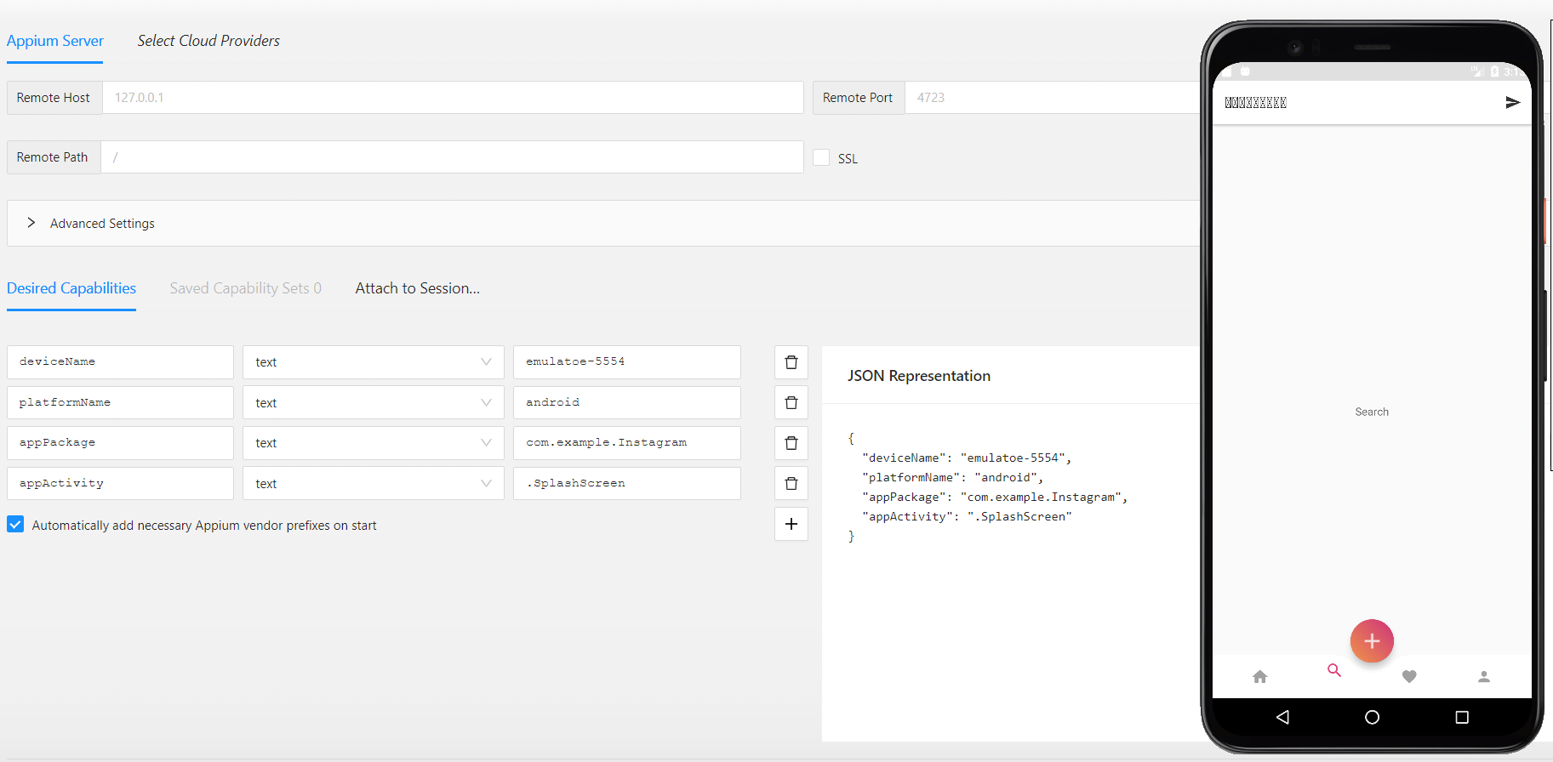
TESTING OUTPUTS

Slide 15
CONCLUSION
Hence , automation of Instagram is successfully done using Appium server and inspector with all the possible test scenarios.

Slide 16

THANK YOU

